Slide 1



Cover Page
Monday, 24 Nov 2025
PROJ703/ PROJ903 International Challenge Project “Eurobot”
By
ROBO-UN

Slide 2
SUMMARY
Progress Report -03
Simulation –04-05
Programming -06
Design -07
Conclusion -08
Page - 02

Slide 3
PROGRESS REPORT
What we have done:
Simulation: Slam integration, Performance Optimization
Design: Modify the Dribbler design and update the robot case
Programming: Aruco code detection update
Page - 02

Slide 4
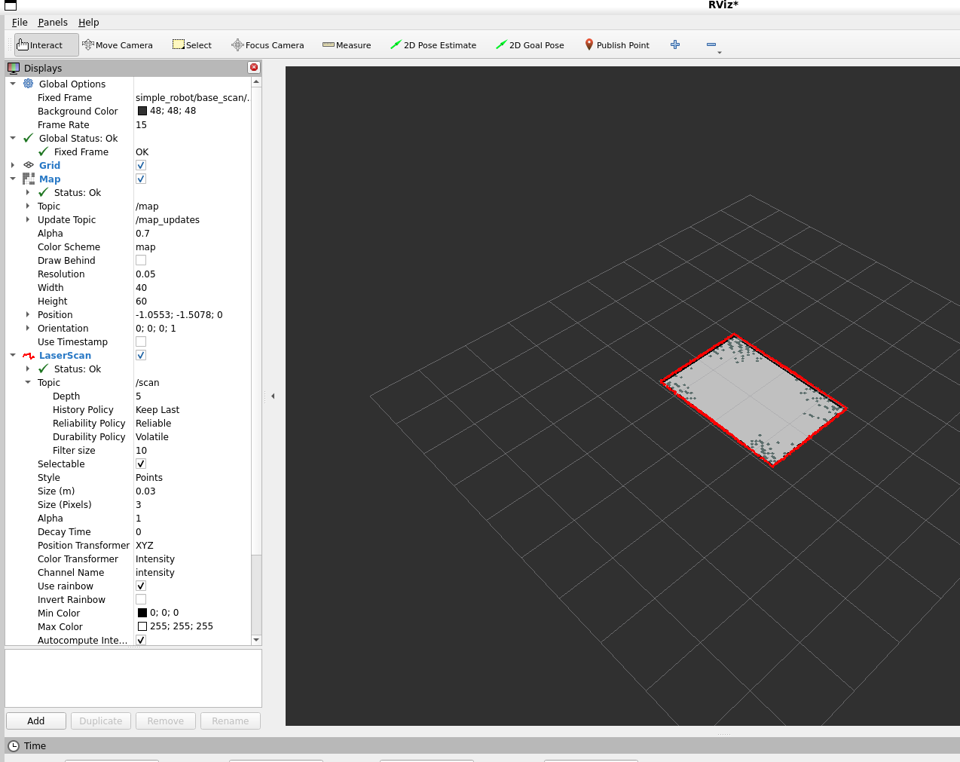
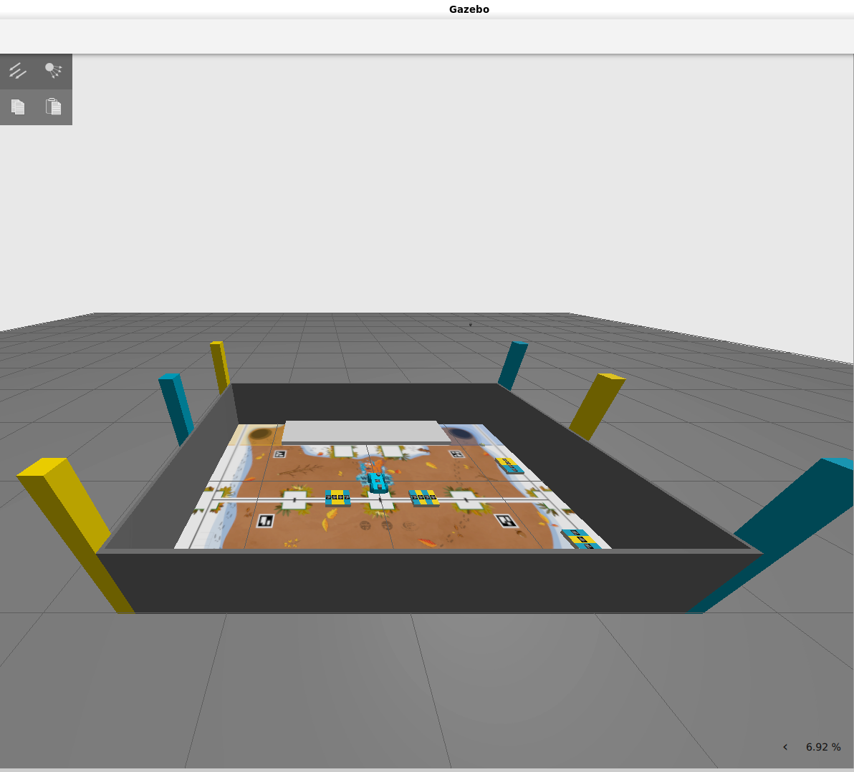
SIMULATION: Slam integration
Slam screen output
Page - 03

Slide 5
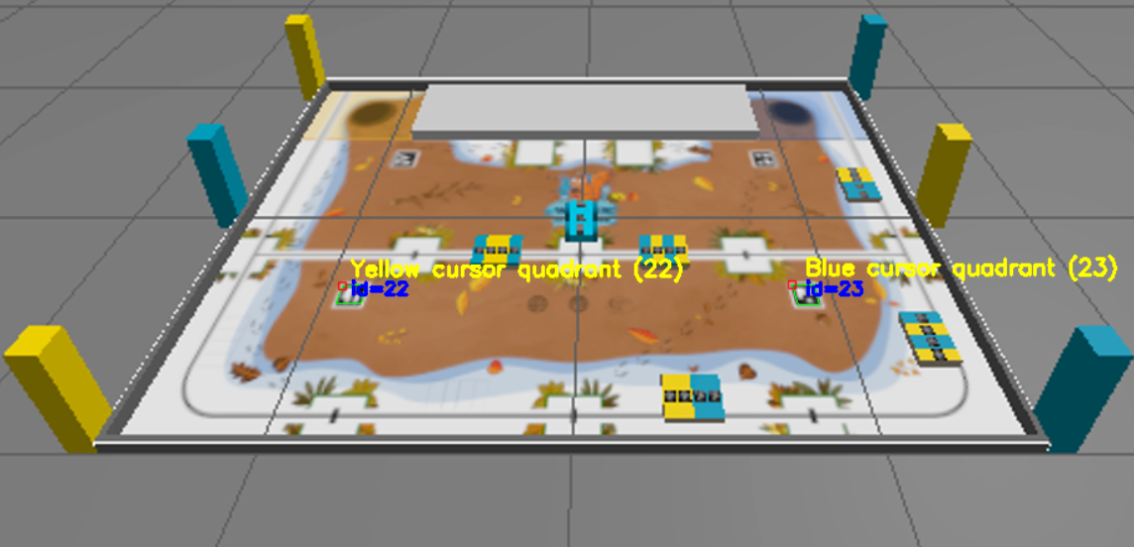
SIMULATION: Aruco detection
Improved detection algorithm
Page - 04

Slide 6
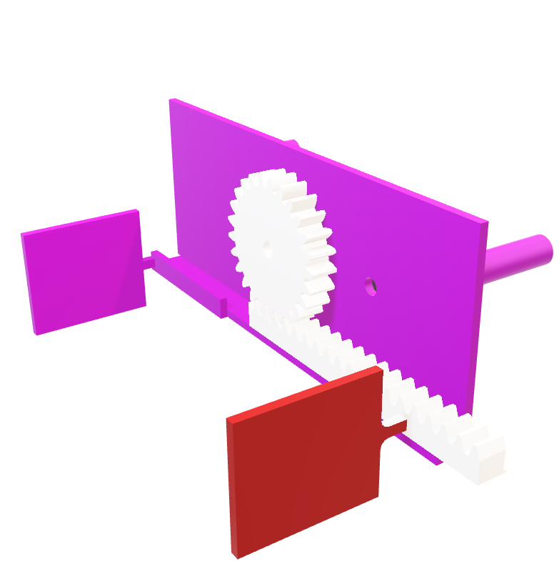
CAD Modelling
Modification:
Maximum opening is 16cm and minimum is 5.6cm.
Rack is extended out of robot casing for 3 cm.
Page - 05

Slide 7
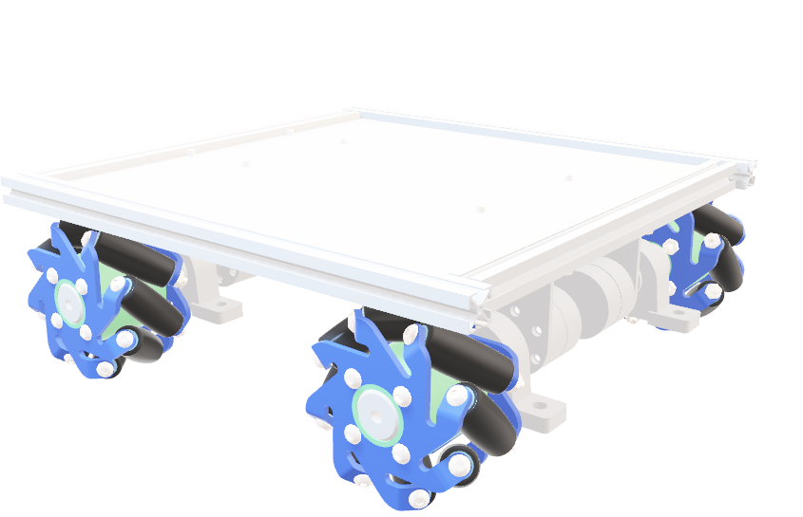
CAD Modelling
Modification: More precise dimensions according to the requirements.
200mm × 200mm
Page - 06

Slide 8
CONCLUSION
What we have to do for next session:
Simulation: Localization node finalization
Design: Robot Body(case), Assembly.
Programming: Aruco code detection integration
Page - 07

